Slide 1
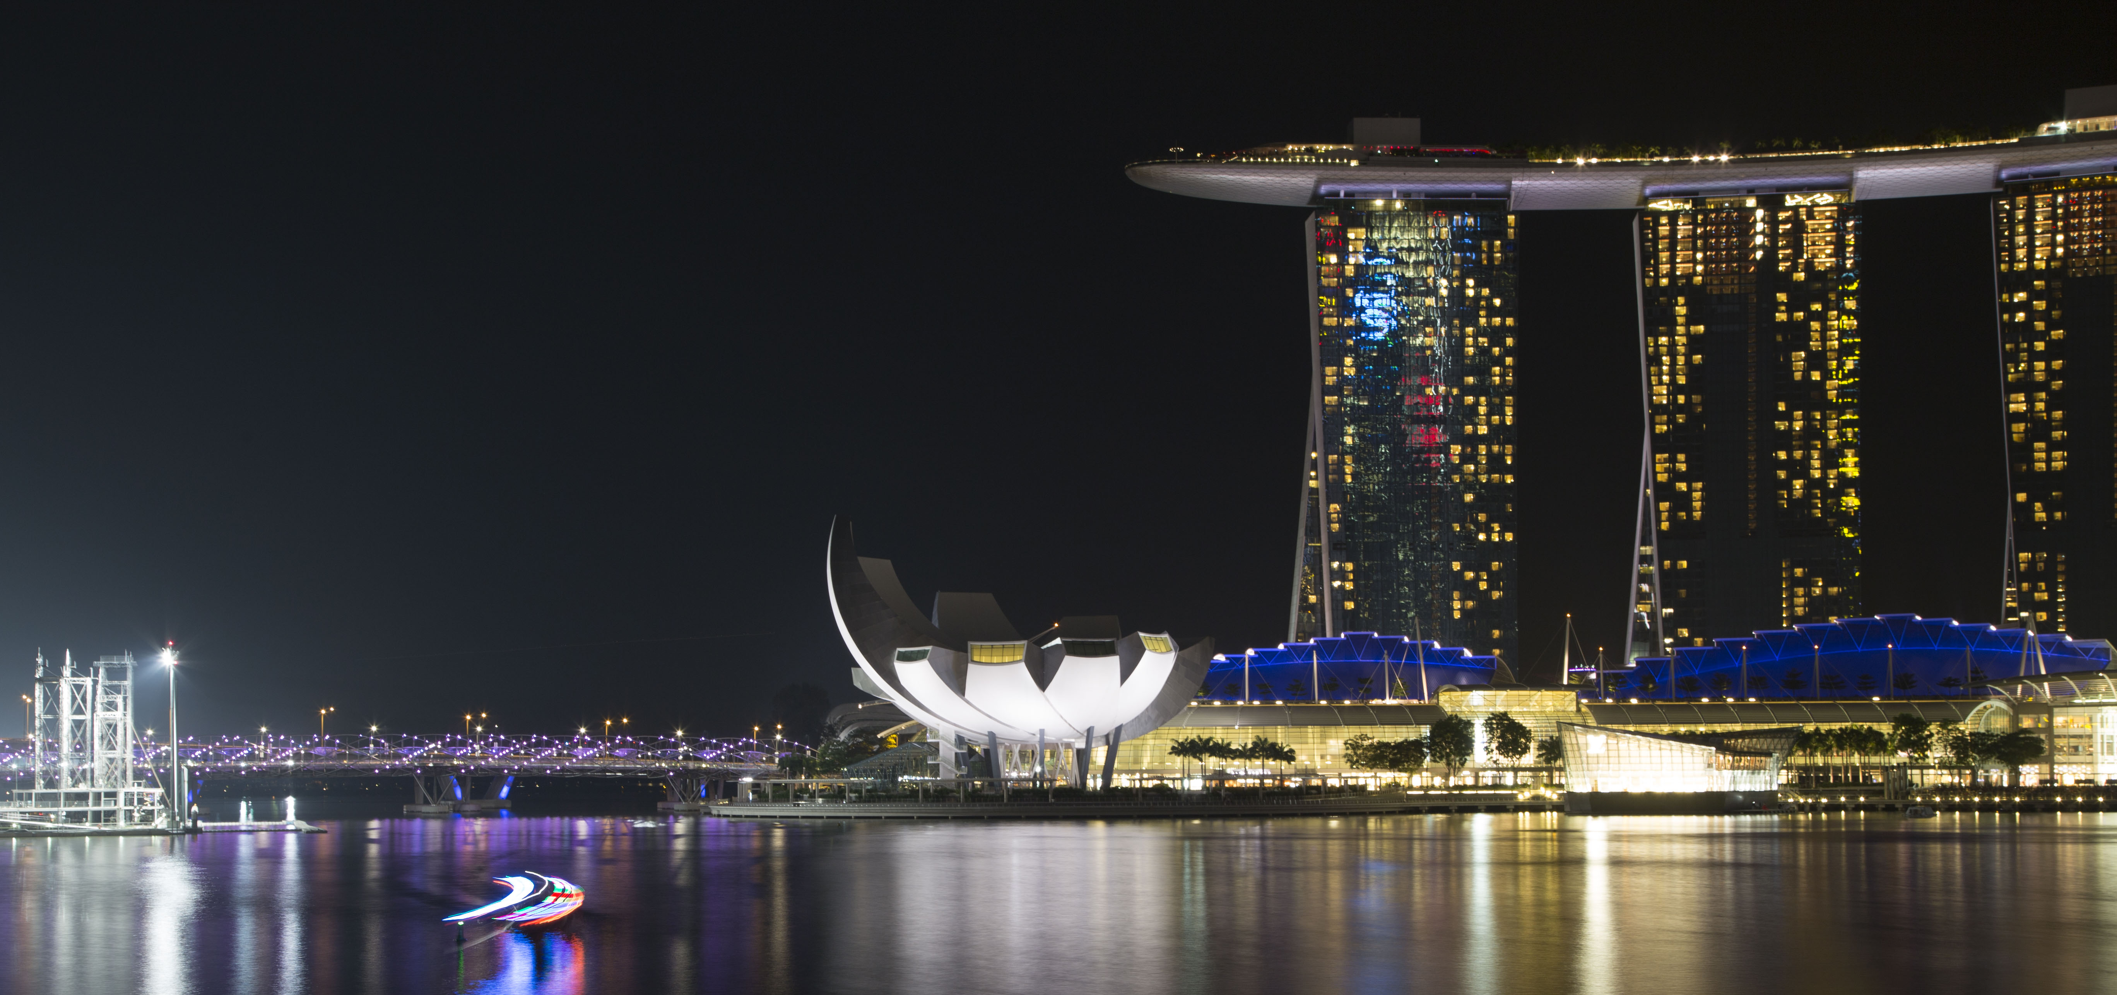






PowerShell Conference Asia
Automating Any Tasks
with Powershell and Friendly
Tomoya Yamanaka

Slide 2

Self-Introduction
Name: Tomoya Yamanaka
Nationality: Japan
Work: IVP Global Philippines inc.
Contact: www.facebook.com/tomoya.yamanaka.54
Hobby: IT community activity
PowerShell Conference
Singapore 2017

Slide 3
Introduction for Special Assistant
Name: Takuya Ishikawa
Work: Codeer ltd., President
Title: Micorosft MVP(2014 ~ )
Contact: twitter: @StoneGuitar777
Programs: Friendly, LambdicSql, QuickShot
PowerShell Conference
Singapore 2017

Slide 4
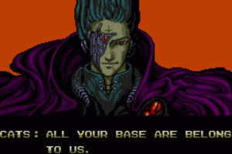
Today’s target!!
Get the way to take your entire PC app controls
“with PowerShell and Friendly”
PowerShell Conference
Singapore 2017
https://en.wikipedia.org/wiki/All_your_base_are_belong_to_us

Slide 5
Demo
PowerShell Conference
Singapore 2017

Slide 6




Agenda
Why PowerShell + Friendly
What is Friendly
What can PowerShell + Friendly do?
Special thanks:
Wankuma
Alliance
PowerShell Conference
Codeer ltd.
Singapore 2017

Slide 7

PowerShell
Now PowerShell is everywhere in Windows PCs!
PowerShell Conference
Singapore 2017

Slide 8
Why is PowerShell nice?
It’s already integrated in Windows.
OS Version | Integrated PowerShell Version
Windows Server 2008 | PowerShell 1.0
Windows 7 Windows 2008 R2 | PowerShell 2.0
Windows 8 Windows 2012 | PowerShell 3.0
Windows 8.1 Windows 2012 R2 | PowerShell 4.0
Windows 10 | PowerShell 5.0
Windows 2016 | PowerShell 5.1
PowerShell Conference
Singapore 2017

Slide 9
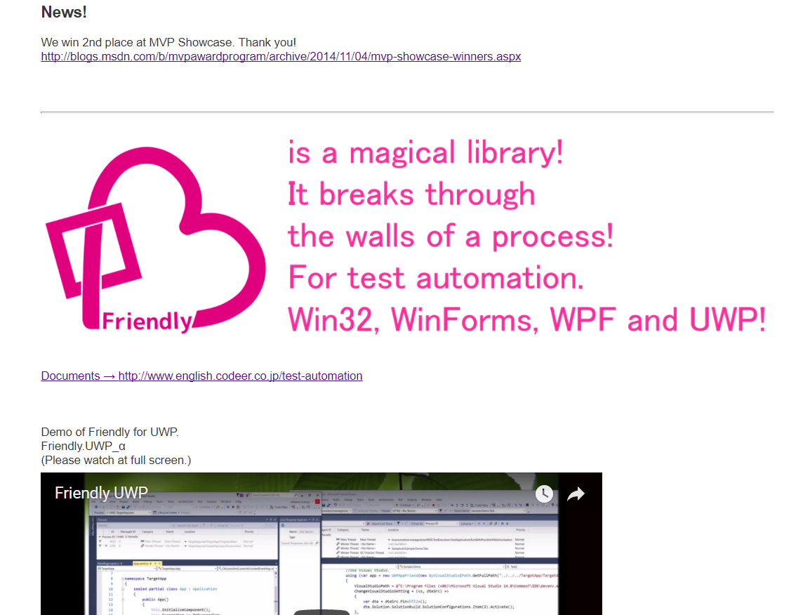
Friendly
http://www.english.codeer.co.jp/
PowerShell Conference
Singapore 2017

Slide 10
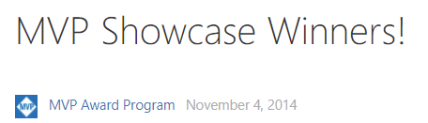
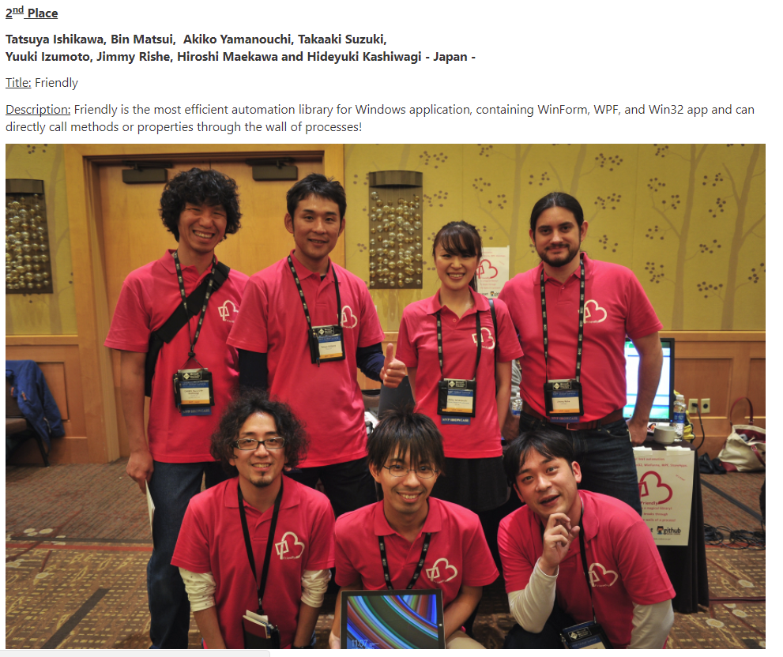
Made by Them Winning 2nd place in 2014 MVP Show case
https://blogs.msdn.microsoft.com/mvpawardprogram/2014/11/04/mvp-showcase-winners/
PowerShell Conference
Singapore 2017

Slide 11
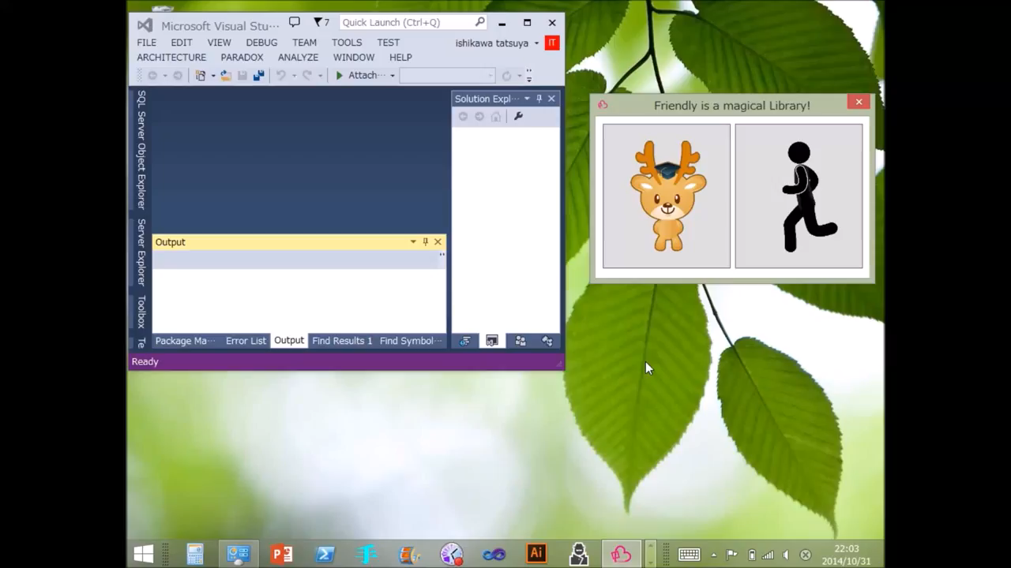
Friendly Demo Video
PowerShell Conference
Singapore 2017

Slide 12
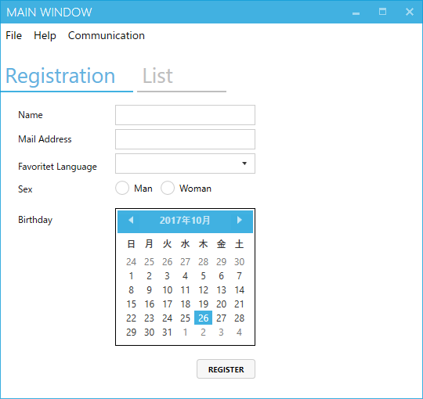

Friendly Program Hack Image
<UserControl x:Class="WpfApplication.ViewControl"
xmlns="http://schemas.microsoft.com/winfx/2006/xaml/presentation"
xmlns:x="http://schemas.microsoft.com/winfx/2006/xaml"
xmlns:mc="http://schemas.openxmlformats.org/markup-compatibility/2006"
xmlns:d="http://schemas.microsoft.com/expression/blend/2008"
xmlns:local="clr-namespace:WpfApplication"
xmlns:fa="http://schemas.fontawesome.io/icons/"
xmlns:c="clr-namespace:VVMConnection;assembly=VVMConnection"
mc:Ignorable="d"
d:DesignHeight="300" Width="538.298">
<c:Connection.Methods>
<c:MethodCollection>
<c:Method Name ="Show" Invoker="AskDelete">
<c:Method.Target>
<c:MessageBox Button="YesNo" Caption="質問" MessageBoxText="削除しますか？"/>
</c:Method.Target>
</c:Method>
</c:MethodCollection>
</c:Connection.Methods>
<Grid>
<Grid.RowDefinitions>
<RowDefinition Height="80"/>
<RowDefinition Height="*"/>
</Grid.RowDefinitions>
<Canvas Grid.Row="0">
<TextBlock Text="Name" Canvas.Left="10" Canvas.Top="19" Width="128"/>
<TextBlock Text="Favoritet Language" Canvas.Left="143" Canvas.Top="19" Width="128"/>
<TextBox Canvas.Left="10" Canvas.Top="40" Width="128" Text="{Binding NameSearch.Value}"/>
<ComboBox Canvas.Left="143" Canvas.Top="40" Width="128" SelectedValue="{Binding LanguageSearch.Value}“
ItemsSource="{Binding Source={x:Static local:Candidates.LanguageWithEmpty}}"/>
<Button Canvas.Left="284" Canvas.Top="40" Height="25" Width="43" Click="{c:Event Search}">
<fa:ImageAwesome Icon="Search"/>
</Button>
<Button Canvas.Right="20" Canvas.Top="40" Height="25" Width="36" Click="{c:Event Erase}">
<fa:ImageAwesome Icon="Eraser"/>
</Button>
</Canvas>
public ReactiveProperty<string> NameSearch { get; set; } = new ReactiveProperty<string>();
public ReactiveProperty<string> LanguageSearch { get; set; } = new ReactiveProperty<string>();
public ReactiveProperty<EntryInfoDataGridRowVM> SelectedItem { get; set; } = new ReactiveProperty<EntryInfoDataGridRowVM>();
public ObservableCollection<EntryInfoDataGridRowVM> EntryInfos { get; set; } = new ObservableCollection<EntryInfoDataGridRowVM>();
public Func<bool?> AskDelete { get; set; }
public ViewControlVM(List<EntryInfo> infos)
{
_infos = infos;
infos.ForEach(e=>EntryInfos.Add(new EntryInfoDataGridRowVM(e)));
}
public void Search()
{
IEnumerable<EntryInfo> result = _infos.ToArray();
if (!NameSearch.IsNullOrEmpty()) result = result.Where(e => e.Name.ToLower().Contains(NameSearch.Value.ToLower()));
if (!LanguageSearch.IsNullOrEmpty()) result = result.Where(e => e.Language == LanguageSearch.Value);
EntryInfos.Clear();
result.ToList().ForEach(e => EntryInfos.Add(new EntryInfoDataGridRowVM(e)));
}
public void Erase()
{
if (SelectedItem.Value == null) return;
if (AskDelete() != true) return;
_infos.Remove(SelectedItem.Value.Core);
Search();
}
Friendly doesn’t access GUI components,
but hack the internal app APIs.
Thus, it’s extremely powerful.
PowerShell Conference
Singapore 2017

Slide 13
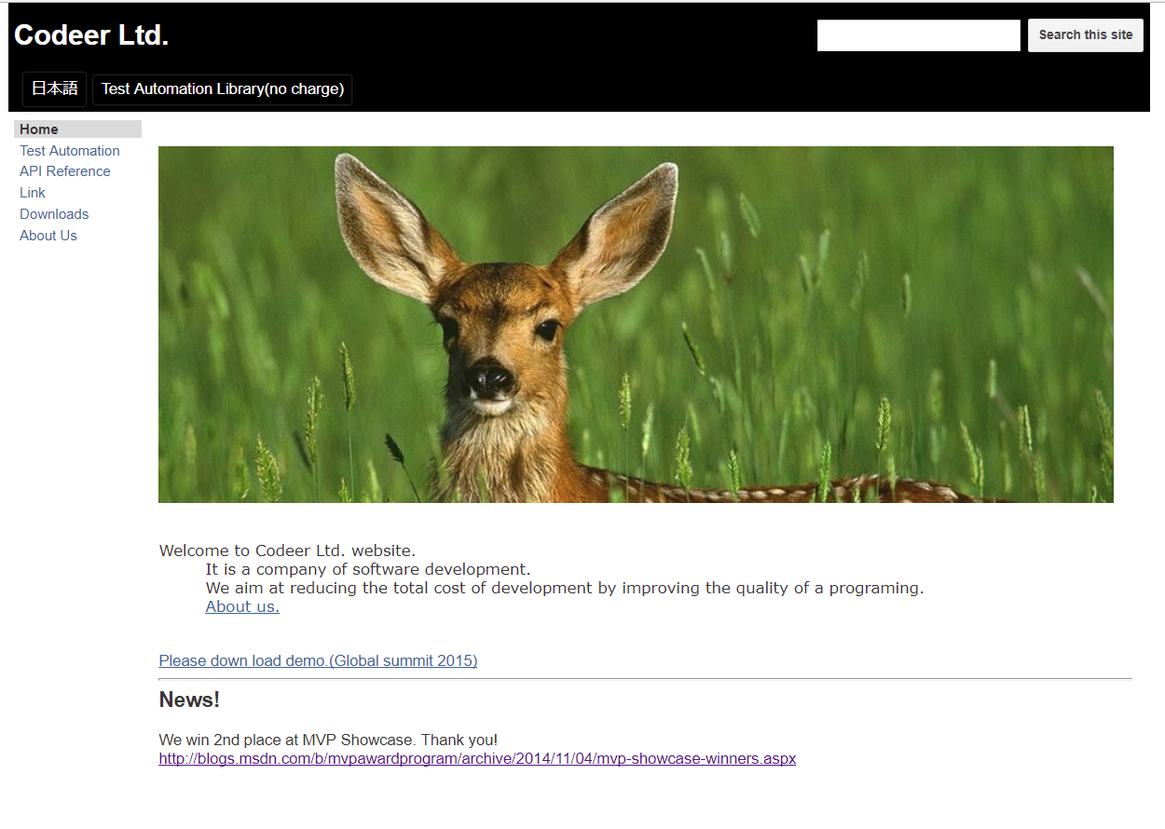
There is Official Company, Codeer Ltd.
PowerShell Conference
http://www.english.codeer.co.jp/
Singapore 2017

Slide 14
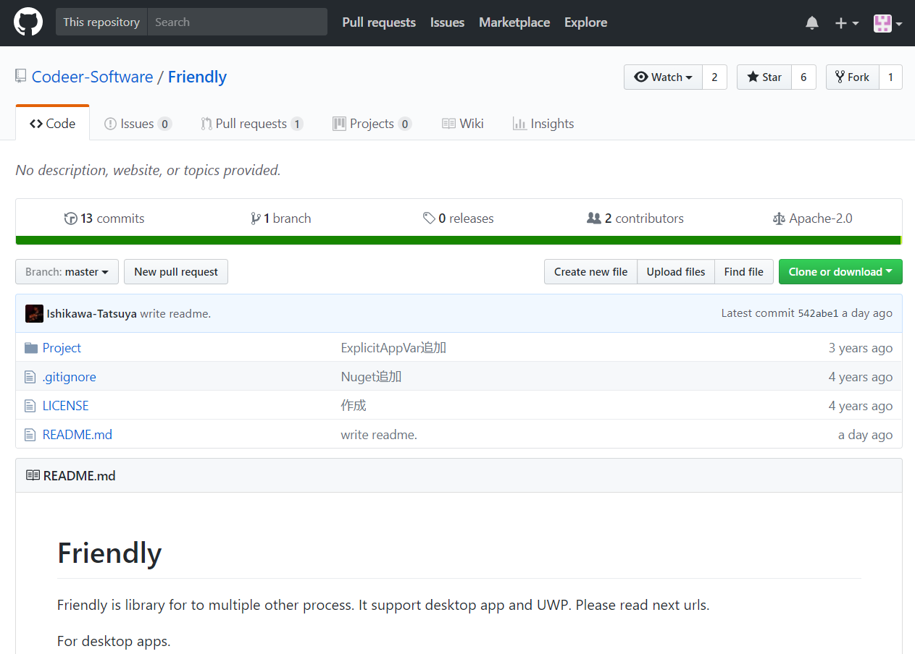
Open Source Software in GitHub
PowerShell Conference
https://github.com/Codeer-Software/Friendly
Singapore 2017

Slide 15


PowerShell + Friendly becomes a strong solution!!
+
PowerShell Conference
Singapore 2017

Slide 16
Friendly is Powerful!!
Friendly is a test library.
It’s the most strong one to manipulate Windows apps!
For example, because it can handle apps accurately, it can won’t fail to take
a timing in high speed move.
The coming demo will be done by the creator, Mr. Ishikawa, due to the app
which is from Ishikawa’s client and approved to show.
The app is originally work with a USB barcode reader, but the part is
replaced by a mock for the test.
Friendly can even replace a part of existing app.
PowerShell Conference
https://github.com/Codeer-Software/Friendly
Singapore 2017

Slide 17
Demo
PowerShell Conference
Singapore 2017

Slide 18
Q & A
PowerShell Conference
Singapore 2017

Slide 19
Don’t Forget!
Fill in your survey in Mobile app – it’s how we do better!
Don’t lose you badge! You need it for the Social Events
Grab the Speakers for a chat – they all have time for you!
Let everyone know what they are missing on Social Media
#PowerShell
#PSConfAsia
Photos of Marina Bay Credit: Sebastian Szumigalski
PowerShell Conference
Singapore 2017

Slide 20
End?
PowerShell Conference
Singapore 2017

Slide 21
End?
PowerShell Conference
Singapore 2017

Slide 22
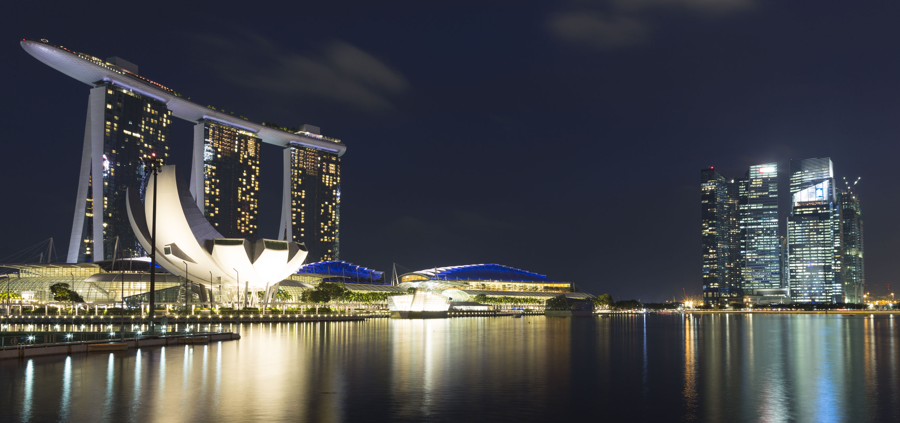
PowerShell Conference Asia
Extention

Slide 23




Self-Introduction again
Name: Tomoya Yamanaka
Home-City: Suzuka city, Japan
Residence: Metro Manila, Philippines
Work: Programmer or System Engineer
JSR[JP] -> Hitachi[JP] -> Empathy[JP] -> IVP[PH]
Etc: IT Community Wankuma Alliance
Manila Director
PowerShell Conference
Singapore 2017

Slide 24
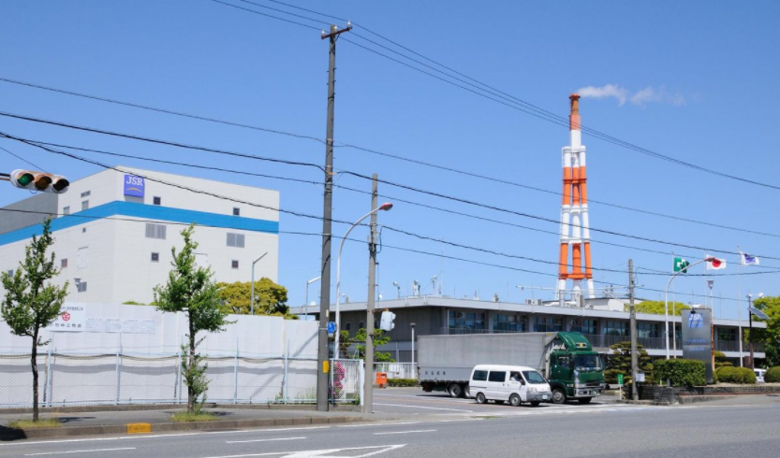
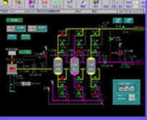
My Career as Factory IT Engineer
PowerShell Conference
Singapore 2017

Slide 25
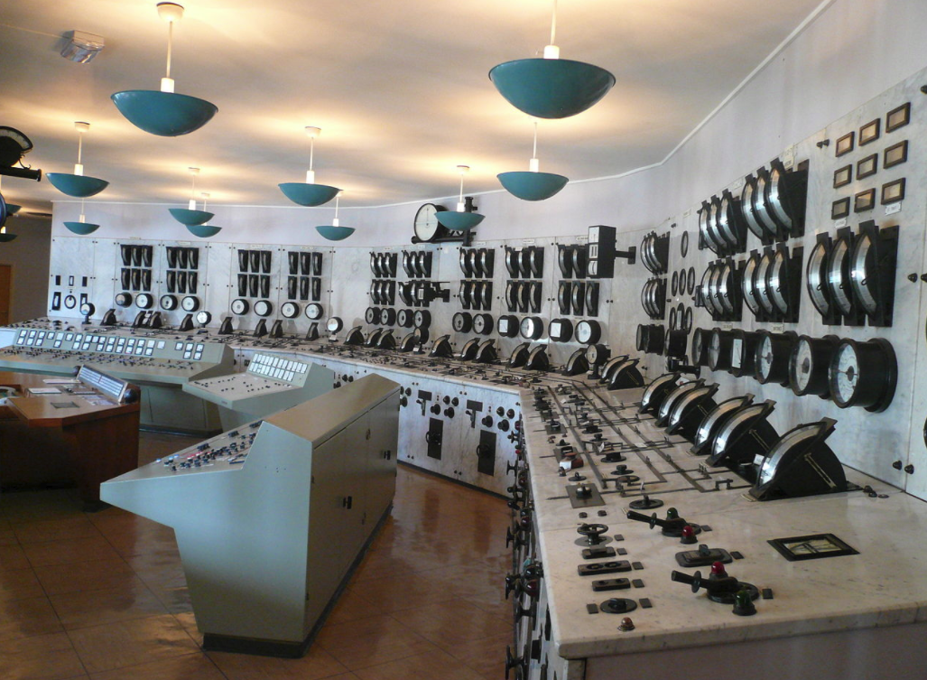
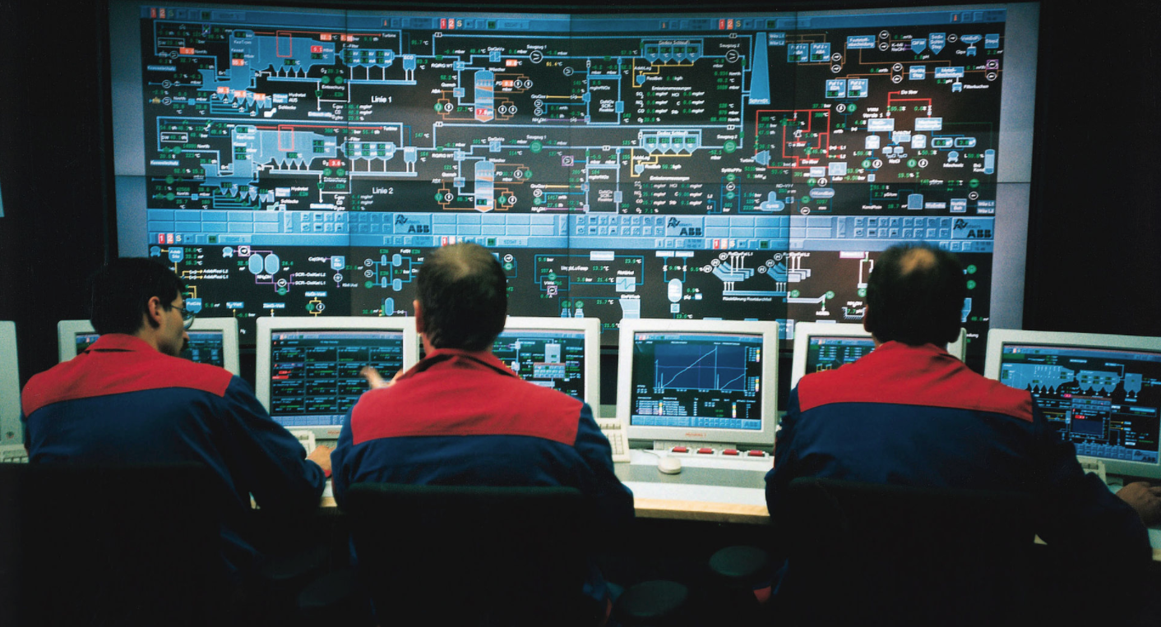
Factory Automation(FA) System, or Distributed Control System(DCS)
Old
New
https://en.wikipedia.org/wiki/Distributed_control_system
PowerShell Conference
Singapore 2017

Slide 26
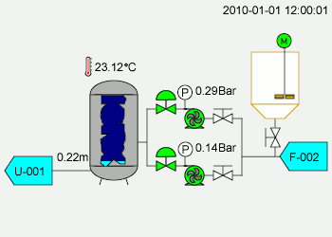
System needs to be tested
https://en.wikipedia.org/wiki/SCADA
PowerShell Conference
Singapore 2017

Slide 27
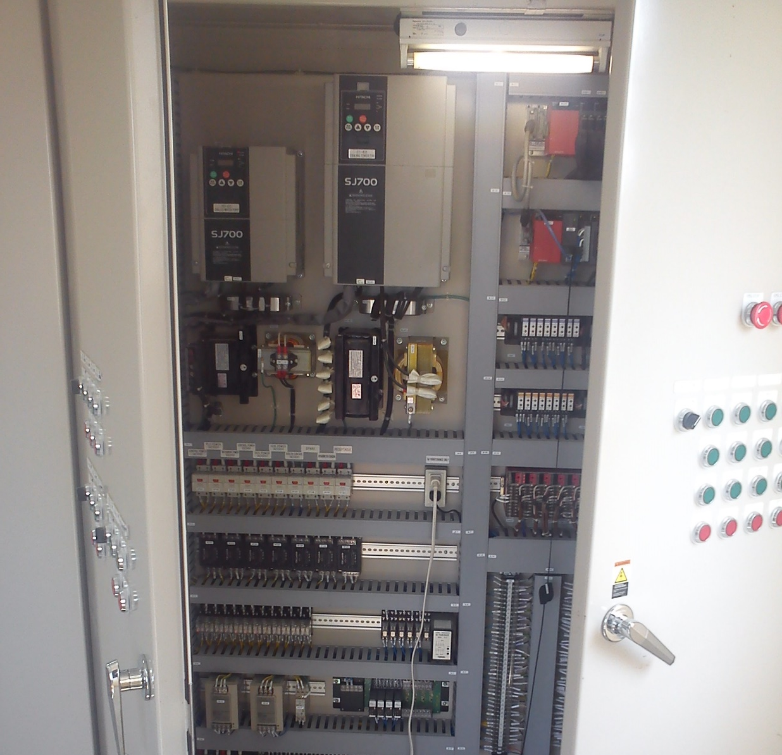
System Control Panel
PowerShell Conference
Singapore 2017

Slide 28
Challenge 1: System Control Panel
We cannot
move it!!
PowerShell Conference
Singapore 2017

Slide 29
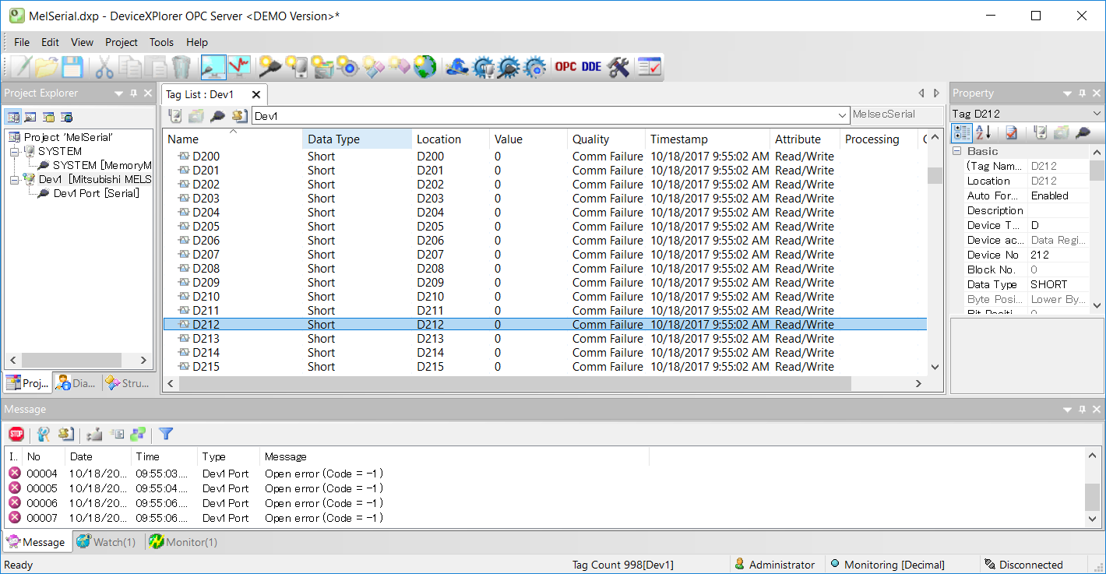
Challenge 2: Special Software for Control Panel
No I/F for Automation
PowerShell Conference
Singapore 2017

Slide 30
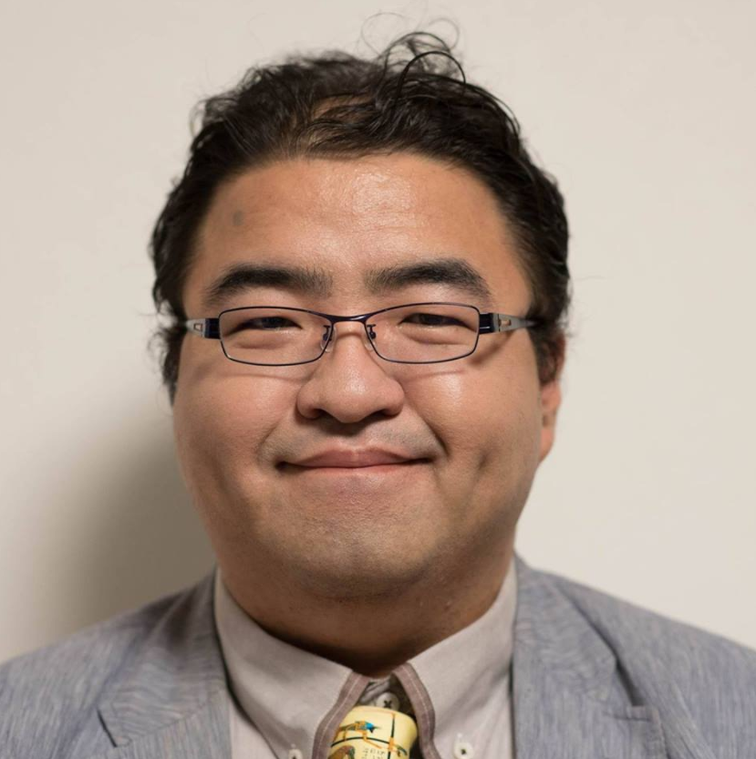
Challenge 3: Approval from Boss
Hirotoshi Naka
Founder of Japan IT group
Wankuma Alliance
PowerShell Conference
Singapore 2017

Slide 31
PowerShell + Friendly can solve all!!
+
PowerShell Conference
Singapore 2017

Slide 32
True End
PowerShell Conference
Singapore 2017

